Slide 1
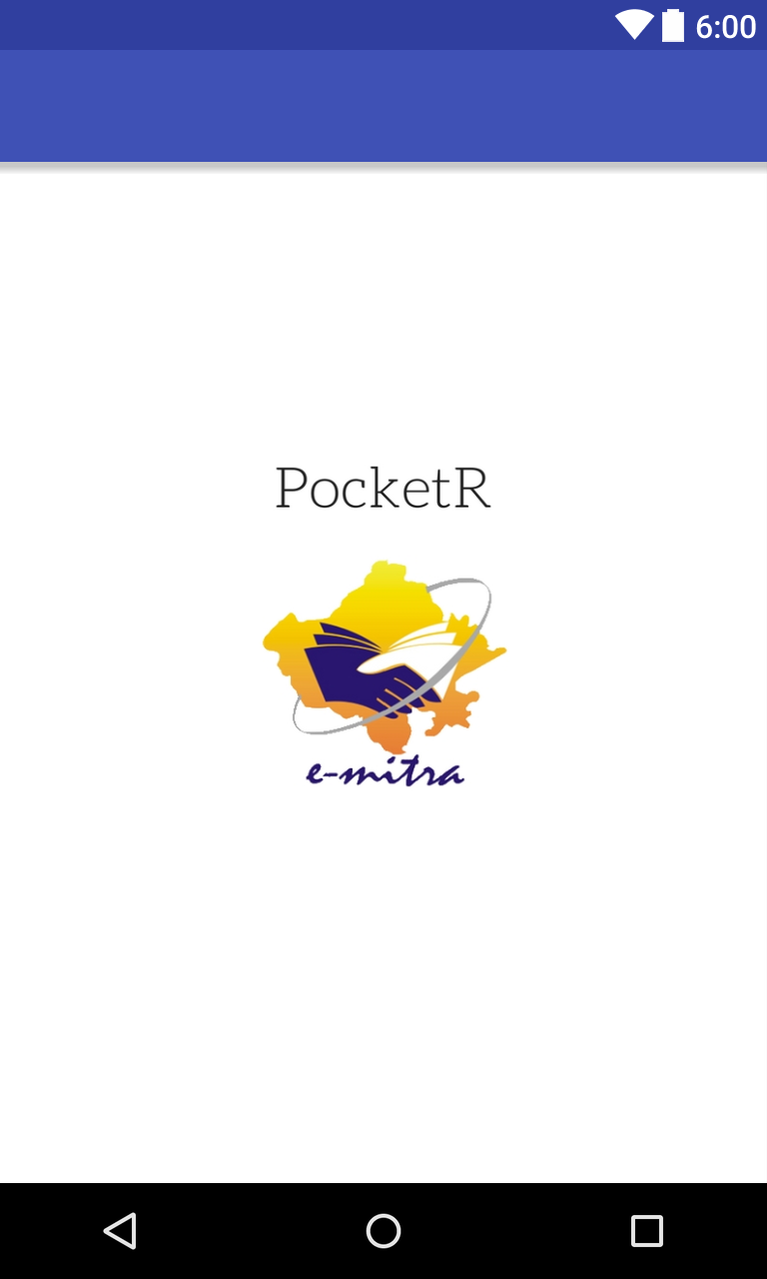
Welocome to the PocketR
A Smart Interface to Monitor All
E-mitra and other Services

Slide 2
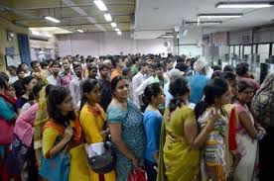
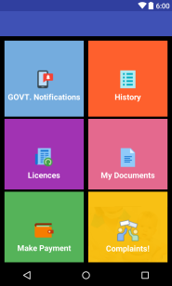
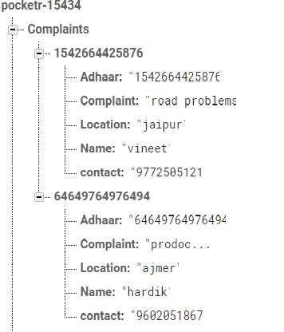
Easy Complaints Monitoring
Without PocketR(Long Queues)
With Pocket8
Monitoring
Complaints
Office
user

Slide 3
Easy Complaint Monitoring
Impact on Society
Citizens not need to go anywhere or not need to make calls for complaints, Everything could be monitor by pocketR.
No more paper work and no extra complain offices need to be set up for just monitoring complaints .

Slide 4
Real Time Government Notification
A real time Notification from Government can be delivered to all the users, the Notification could be new Government schemes, new tax policies , and all the notification can be delivered and monitored by the dashboard.
Impact on society-users need not to read different newspaper or surf on websites to get latest gov. updates, Everything could be done by PocketR.

Slide 5
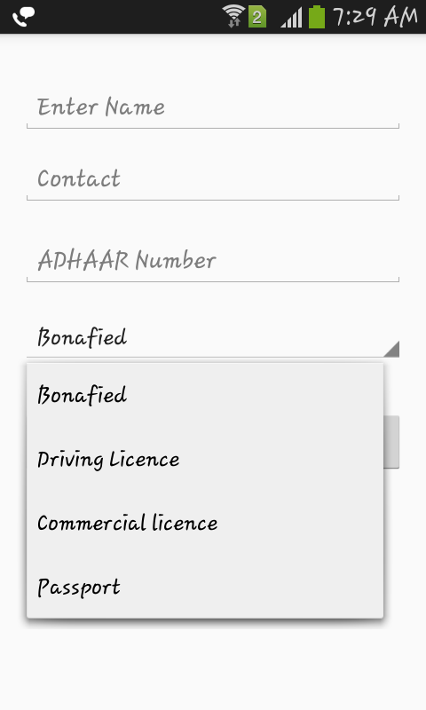
Digital Signatured Licences with payment Integration
A unified interface to request all kinds of identification Licences like Bonafide ,Driving Licence ,Commercial licence ,passport etc and monitor all through DashBoard.

Slide 6
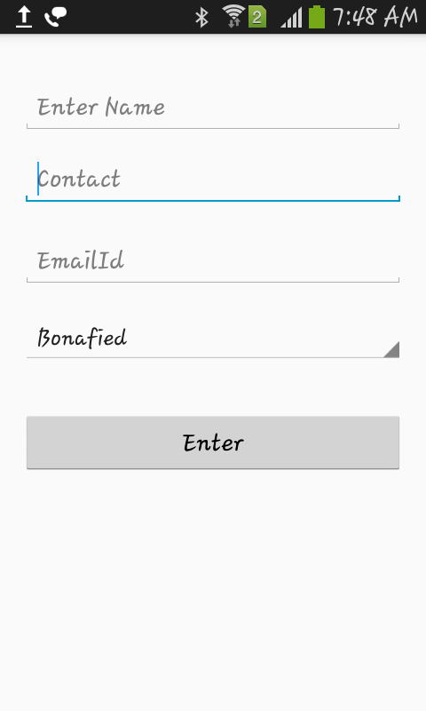
Digital Signatured Licences with payment Integration
Payment can also processed through PocketR using E-mitra
Transaction API

Slide 7

Document Wallet(developing phase)
A single Wallet for keeping all daily and necessary documents to your PocketR wallet.

